Slide 1


Sarcasm Detection in IMDb Movie Reviews

Slide 2
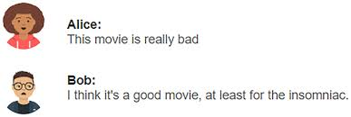
Business Problem
Online reviews hold immense power in the film industry, shaping audience perception and box office success. However, sarcasm, a common weapon in the reviewer's arsenal, can wreak havoc on sentiment analysis systems. These automated tools struggle to decipher sarcastic intent, leading to misinterpretations that can skew audience ratings, mislead studios, and ultimately, disappoint moviegoers.

Slide 3
Proposed Solution
Our proposed solution is to build a machine learning and Deep learning models that capable of identifying sarcasm in IMDb reviews.
Scope of the Solution
In-scope:
Developing a sarcasm detection model specifically for English-language IMDb reviews.
Evaluating model performance using a curated dataset of IMDb reviews.
Focusing on text-based reviews, excluding multimedia content.
Out-of-scope:
Detecting sarcasm in non-English reviews.
Handling non-textual sarcasm (e.g., in images or videos or memes).
Real-time detection of sarcasm during review submission.

Slide 4
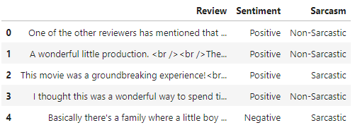
Dataset Description
The reviews are directly from IMDb, ensuring the context and language used are highly relevant to our target application. The large volume of reviews provides sufficient data for training robust
machine learning models.
Characteristics : The dataset consists of a rich archive of text reviews for movies, gathered from IMDb.
Pros : Labeled as positive or negative review
Cons : We're enriching our dataset by manually classifying reviews as sarcastic or non-sarcastic using available tools
Ref : IMDb Dataset

Slide 5
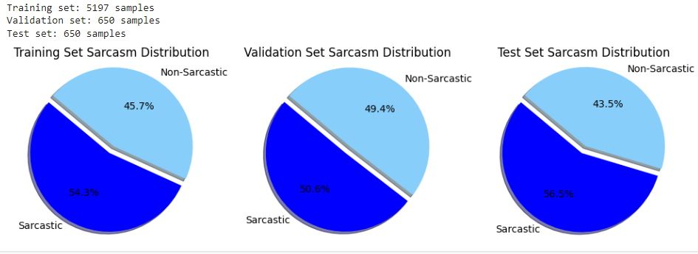
Data Visualization
Total Datpoints : 6497
Train Set : 5197
Test Set : 650
Validation Set : 650

Slide 6
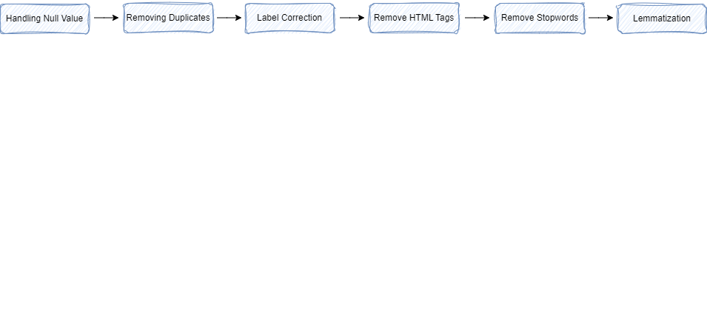
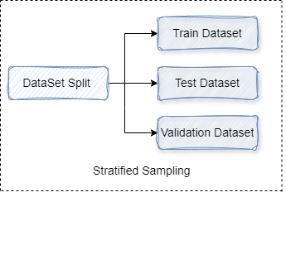
Data Preprocessing:
Data Cleaning
Data Split and Sampling
Ensure that the distribution of sarcasm and non-sarcasm labels is consistent across the training, validation, and test sets to maintain a balanced representation of classes.

Slide 7
Tokenization and Embedding Techniques
Machine Learning Model : Random Forest Model
Tokenization : Removing Stop Words and Lemmatization
Embedding : TF-IDF Vectorization
Deep Learning Model :Using Pre-trained RoBERTa Model
Tokenization with RoBERTa : WordPiece Tokenization
Special Tokens : [CLS]
Embedding Using Pre-trained RoBERTa :
Pre-trained Weights - helps in capturing rich contextual information and improves performance on downstream tasks
Fine-tuning - For the sarcasm detection task, the pre-trained BERT model is fine-tuned on the specific dataset.

Slide 8
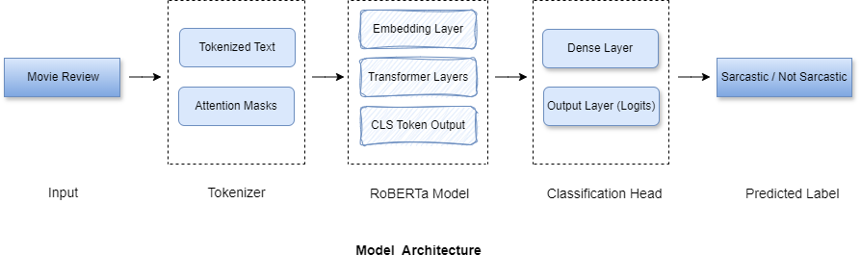
Model- Deep Learning Model
RoBERTa (Robustly optimized BERT approach) Model
RoBERTa, like BERT, is based on the Transformer architecture. It uses multiple layers of self-attention mechanisms to process input text and generate contextualized embeddings

Slide 9
Implementation Details:
Tokenization:
Uses RobertaTokenizer, which is based on Byte-Pair Encoding (BPE).
It splits text into subword units, adds special tokens, and ensures consistency in text preprocessing.
Model Architecture:
RobertaModel: The core model generates contextualized embeddings.
RobertaForSequenceClassification: A variant used for classification tasks, including an additional classification layer on top of the core model.
Training Process:
Input Preparation: Convert text into token IDs and attention masks.
Forward Pass: Pass inputs through the model to get logits.
Loss Calculation: Compute loss using cross-entropy for classification tasks.
Backpropagation: Update model weights based on the computed loss.

Slide 10
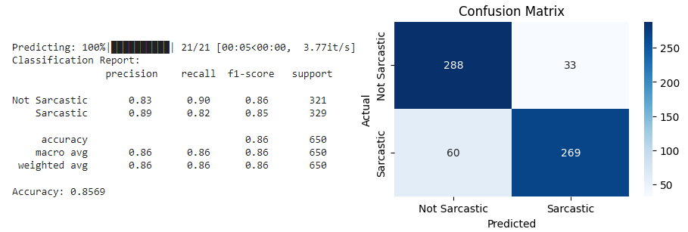
Evaluation metrics
Evaluating the performance of a sarcasm detection model, several metrics can be used to assess its effectiveness.
The RoBERTa model's performance highlights its robustness and effectiveness in handling the complexities of sarcasm detection in movie reviews. Its ability to achieve high precision, recall, and F1-scores for both sarcastic and non-sarcastic classes makes it a best model for this task.

Slide 11
Thank You!

